Slide 1
3D object detection for autonomous driving
Submitted to
Dr. S.N Omkar
Chief Research Scientist
Aerospace Engineering Dept.
IISc Bangalore
Project Guide
Ramesh K.N

Slide 2
How stereo R-CNN is differ/better than monocular and LiDAR based 3D Object Detection methods.
LiDAR: Most of the 3D object detection methods heavily rely on LiDAR data for providing accurate depth information in autonomous driving scenarios. But LiDAR has the disadvantage of high cost, relatively short perception range.
Monocular: It uses one camera, it provides alternative low-cost solutions for 3D object detection. The depth information can be predicted by semantic properties in scenes and object size, etc. However, the inferred depth cannot guarantee the accuracy, especially for unseen scenes.
Stereo: It uses two or more cameras, Comparing with monocular camera, stereo camera provides more precise depth information and comparing with LiDAR, stereo camera is low-cost while achieving comparable depth accuracy for objects.

Slide 3
Stereo R-CNN extends Faster R-CNN, for stereo inputs to simultaneously detect and associate object in left and right images.
-> R-CNN – Region Convolutional Neural Network
Evolution of R-CNN :
R-CNN -> Fast R-CNN -> Faster R-CNN
R-CNN : It has three separate models.
(a) Input images (b) extract Region proposals (c) compute CNN features
Classify Regions(using SVM)
Bounding box(Runs simple linear regression in regional proposal to generate a tighter bounding box coordinates)
Fast R-CNN : Those three models of R-CNN are combined to form one model.
Faster R-CNN : We reuse the same CNN features instead of running selective search.

Slide 4
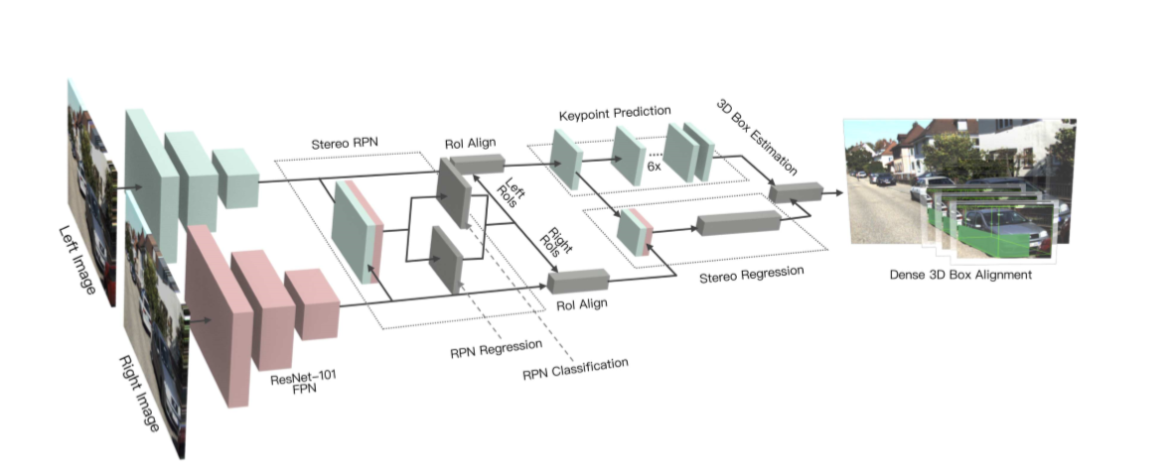
Stereo R-CNN Network
Stereo RPN(Regional Proposal Network)
Stereo R-CNN
Stereo Regression
Key point Prediction
3D Box Estimation

Slide 5
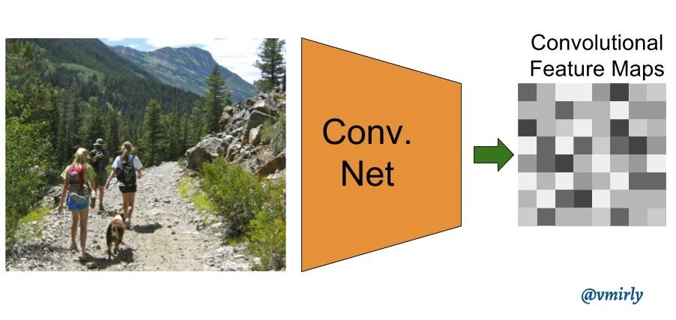
Stereo R-CNN Network:
We use weight-share ResNet-101 and FPN as our backbone network to extract consistent features on left and right images.
Here ResNet means : Residual Network
101 indicates number of Layers.
FPN : Feature Pyramid Network
This ResNet-101 produce convolutional Feature maps as output of last layer.
we concatenate left and right feature maps at each scale, then we feed the concatenated features into the stereo RPN network.

Slide 6
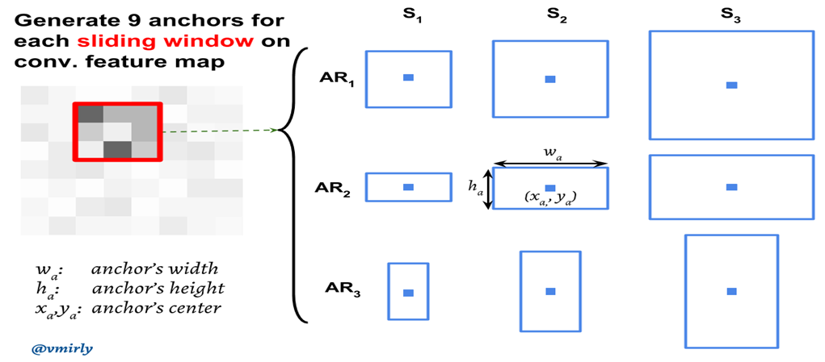
Stereo RPN (Region Proposal Network)
It is a sliding window based foreground detector. The size of sliding window is ‘n x n’ (here 3×3). For each sliding window, a set of 9 anchors are generated which all have the same center (x ,y ) but with 3 different aspect ratios and 3 different scales as shown below. Note that all these coordinates are computed with respect to the original image. Furthermore, for each of these anchors, a value p∗ is computed which indicated how much these anchors overlap with the ground-truth bounding boxes.
a b

Slide 7
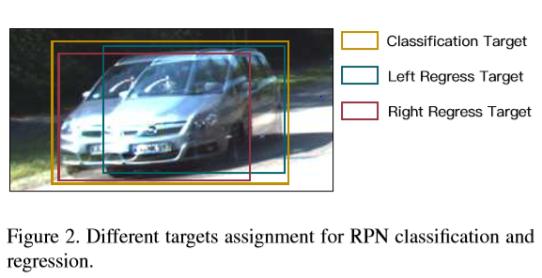

we assign the union of left and right GT boxes (referred as union GT box) as the target for objectness classiﬁcation. An anchor is assigned a positive label if its Intersection-over-Union (IoU) ratio with one of union GT boxes is above 0.7, and a negative label if its IoU with any of union boxes is below 0.3.
(Anchor ∩ GTBox)
(Anchor ∪ GTBox)
IoU =
p* is 1 if IoU > 0.7
p* is -1 if IoU < 0.3

Slide 8
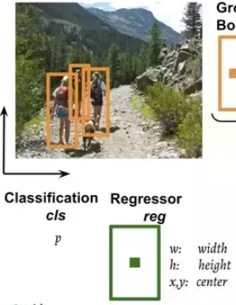
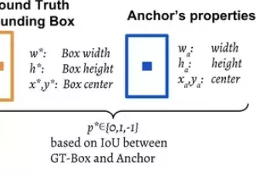
Finally the 3 X 3, spatial features extracted from those convolution feature maps (shown above within red box) are fed to a smaller network which has two tasks: classification (cls) and regression (reg). The output of regressor determines a predicted bounding-box (x, y, w, h), The output of classification sub-network is a probability p* indicating whether the predicted box contains an object(1) or background(0).

Slide 9
Stereo R-CNN
Stereo Regression
Key point Prediction
Stereo Regression : After stereo RPN, we have corresponding left-right proposal pairs. We apply RoI Align on the left and right feature maps respectively at appropriate pyramid level. The left and right RoI features are concatenated and fed into two sequential fully-connected layers (each followed by a ReLU layer) to extract semantic information. We use four sub-branches to predict object class, stereo bounding boxes, dimension, and viewpoint angle respectively.

Slide 10
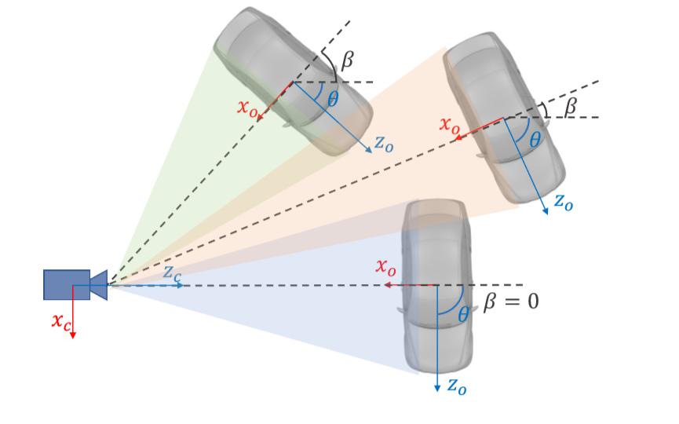
View Point prediction:
we use θ to denote the vehicle orientation respecting to the camera frame, and β to denote the object azimuth respecting to the camera center. Three vehicles have different orientations, however, the projection of them are exactly the same on cropped RoI images. We therefore regress the viewpoint angle α deﬁned as: α = θ + β.
We store the training targets as [sinα,cosα] pair instead of the raw angle value.

Slide 11
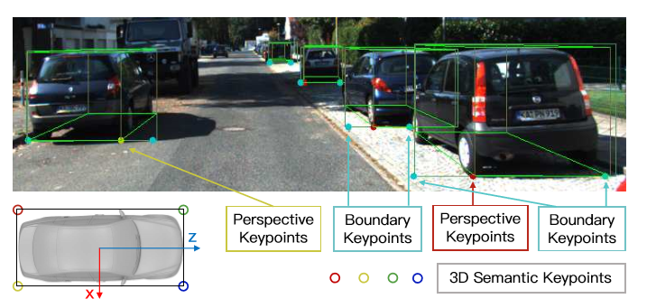
Key Point Prediction:
Besides stereo boxes and viewpoint angle, we notice that the 3D box corner which projected in the box middle can provide more rigorous constraints to the 3D box estimation
we deﬁne four 3D semantic key points which indicate four corners at the bottom of the 3D bounding box. There is only one 3D semantic key point can be visibly projected to the box middle (instead of left or right edges). We deﬁne the projection of this semantic key point as perspective key point.

Slide 12
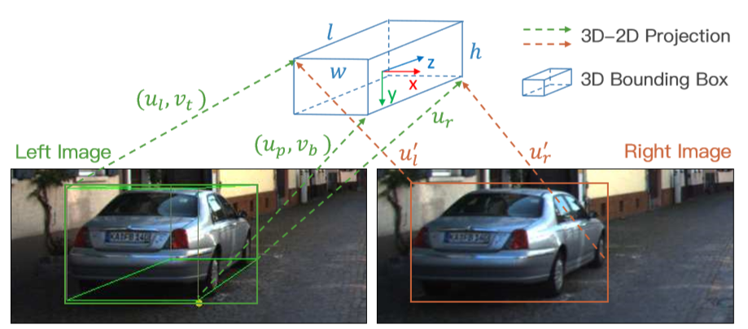

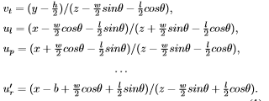
3D Box Estimation:
we solve a coarse 3D bounding box by utilizing the sparse keypoint and 2D box information. States of the 3D bounding box can be represented by x = {x, y, z, θ}, which denotes the 3D center position and horizontal orientation respectively. Given the left-right 2D boxes, perspective keypoint, and regressed dimensions, the 3D box can be solved by minimize the reprojection error of 2D boxes and the keypoint. we extract seven measurements from stereo boxes and perspective keypoints:
z = {ul,vt,ur,vb,u′ l,u′ r,up},
which represent left, top, right, bottom edges of the left 2D box, left, right edges of the right 2D box, and the u coordinate of the perspective keypoint.
we formulate the 3D-2D relations by projection transformations.

Slide 13
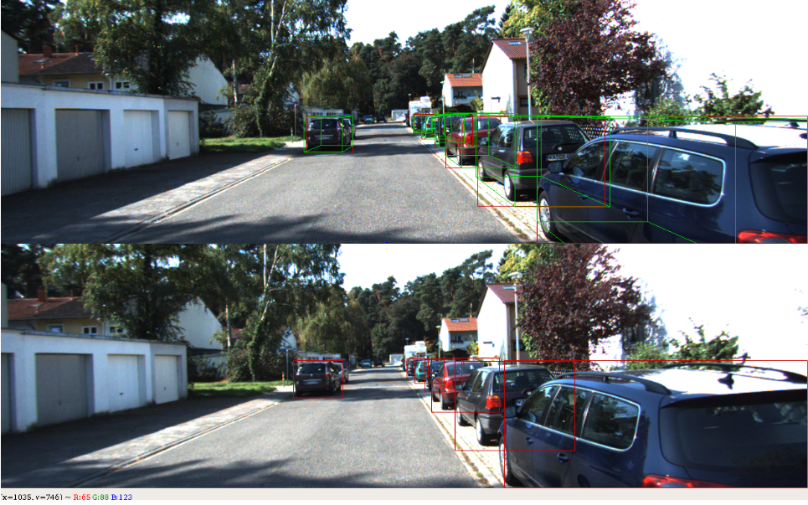
Result :

Slide 14
Scope of Further research:
This Stereo R-CNN is heavy for computation and we know YOLO (You Only Look Once) method is not that heavy for computation.
By combining the YOLO model and Stereo R-CNN, we could even run out 3D Objection Model in our smart phones, as YOLO can be run in smart phones.
It decreases cost also.
No paper is published on these till now.

Slide 15
Thank you sir!

